Slide 1
IT721:Data Mining and Data Warehousing Module 4: Data Mining & Association Rules
Prof. Shailendra Kumar Sonkar
Assistant Professor, Department of Information Technology
University College of Engineering and Technology
Vinoba Bhave University Hazaribag, Jharkhand

Slide 2
Module - 4 Contents
Topics Covered
Data Mining
Definitions
KDD (Knowledge Discovery database) versus Data Mining
DBMS versus Data Mining
Data Mining Techniques
Issues and challenges
Applications of Data Warehousing & Data mining in Government
Association Rules
Apriori algorithms
Partition algorithm
Dynamic itemset counting algorithm
FP- tree growth algorithm
Generalized association rule

Slide 3
Module - 4 Data Mining
Data Mining : Definition
Extracting or “mining” knowledge from large amounts of data
The mining of gold from rocks or sand is referred to as gold mining rather than rock or sand mining
“knowledge mining from data”
Many other terms carry a similar or slightly different meaning to data mining
Knowledge Mining from Data
Knowledge Extraction
Data/Pattern Analysis
Data Archaeology
Data Dredging
Many people treat data mining as a synonym for another popularly used term, Knowledge Discovery from Data, or KDD

Slide 4
Module - 4 Data Mining
Data Mining : Process
Knowledge discovery as a process is depicted in Figure 1.4 and consists of an iterative sequence of the following steps
Data cleaning
To remove noise and inconsistent data
Data integration
Multiple data sources may be combined
Data selection
Data relevant to the analysis task are retrieved from the database
Data transformation
Data are transformed or consolidated into forms appropriate for mining by performing summary or aggregation operations

Slide 5
Module - 4 Data Mining
Data Mining : Process
Data mining
An essential process where intelligent methods are applied in order to extract data patterns
Pattern evaluation
To identify the truly interesting patterns representing knowledge based on some interestingness measures
Knowledge presentation
Visualization and knowledge representation techniques are used to present the mined knowledge to the user
Data mining is the process of discovering interesting knowledge from large amounts of data stored in databases, data warehouses, or other information repositories

Slide 6
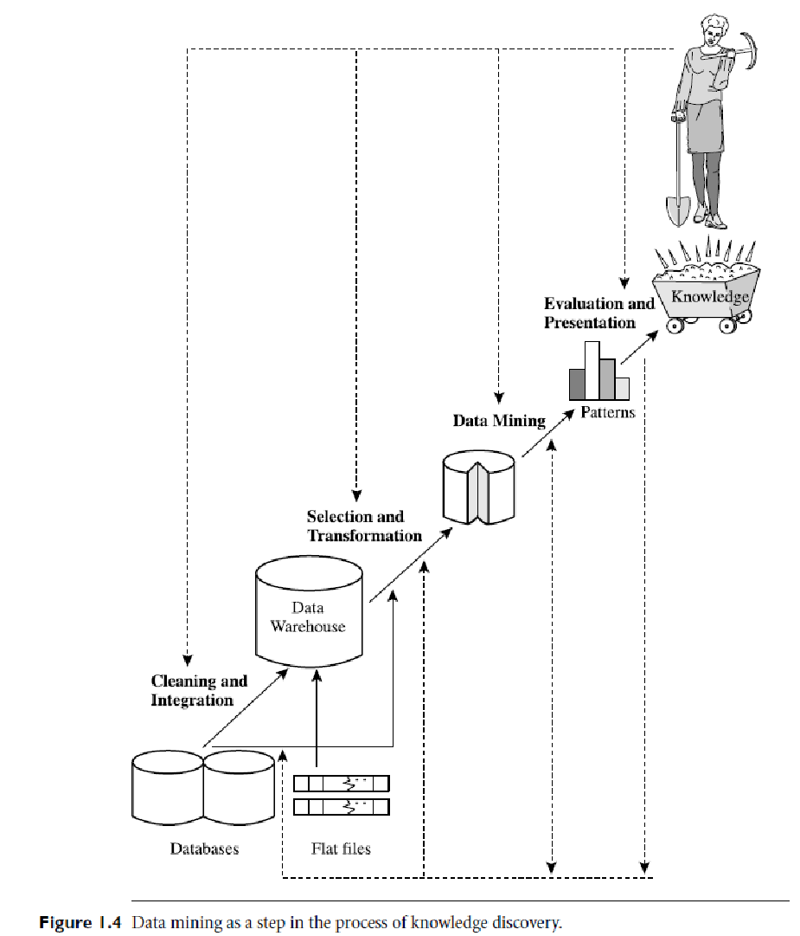
Module - 4 Data Mining

Slide 7
Module - 4 Data Mining
Data Mining : A Typical Architecture
The architecture of a typical data mining system may have the following major components (Figure 1.5)
Database, data warehouse, World Wide Web, or other information repository
This is one or a set of databases, data warehouses, spreadsheets, or other kinds of information repositories
Data cleaning and data integration techniques may be performed on the data
Database or data warehouse server
The database or data warehouse server is responsible for fetching the relevant data, based on the user’s data mining request
Knowledge base
This is the domain knowledge that is used to guide the search or evaluate the interestingness of resulting patterns

Slide 8
Module - 4 Data Mining
Data Mining : A Typical Architecture
Knowledge base
Such knowledge can include concept hierarchies, used to organize attributes or attribute values into different levels of abstraction
Knowledge such as user beliefs, which can be used to assess a pattern’s interestingness based on its unexpectedness, may also be included
Other examples of domain knowledge are additional interestingness constraints or thresholds, and metadata (e.g., describing data from multiple heterogeneous sources)
Data mining engine
This is essential to the data mining system and ideally consists of a set of functional modules for tasks such as characterization, association and correlation analysis, classification, prediction, cluster analysis, outlier analysis, and evolution analysis

Slide 9
Module - 4 Data Mining
Data Mining : A Typical Architecture
Pattern evaluation module
This component typically employs interestingness measures and interacts with the data mining modules so as to focus the search toward interesting patterns
It may use interestingness thresholds to filter out discovered patterns
Alternatively, the pattern evaluation module may be integrated with the mining module, depending on the implementation of the data mining method used
For efficient data mining, it is highly recommended to push the evaluation of pattern interestingness as deep as possible into the mining process so as to confine the search to only the interesting patterns

Slide 10
Module - 4 Data Mining
Data Mining : A Typical Architecture
User interface
This module communicates between users and the data mining system, allowing the user to interact with the system by specifying a data mining query or task, providing information to help focus the search, and performing exploratory data mining based on the intermediate data mining results
In addition, this component allows the user to browse database and data warehouse schemas or data structures, evaluate mined patterns, and visualize the patterns in different forms

Slide 11
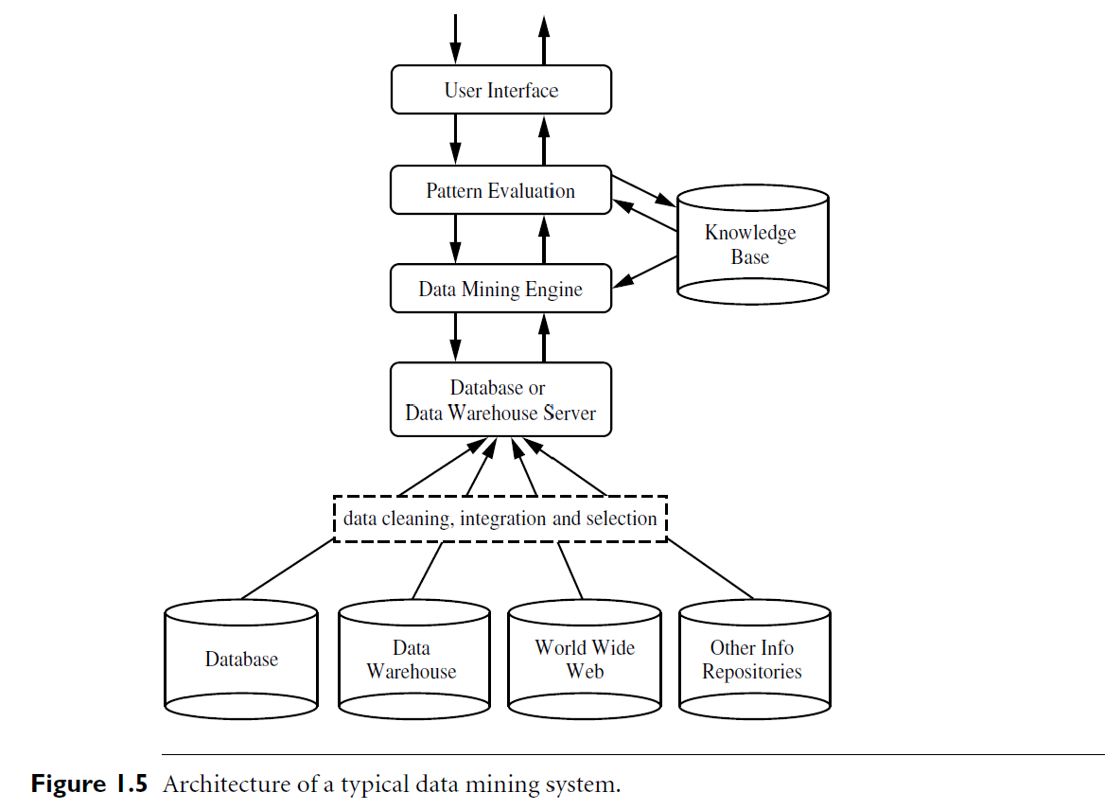
Module - 4 Data Mining

Slide 12
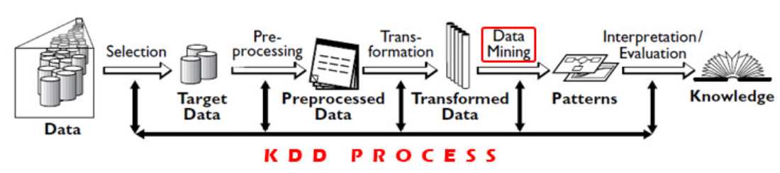
Module - 4 KDD Vs. DM
KDD (Knowledge Discovery Database) versus Data Mining
KDD is the overall process of extracting knowledge from data while Data Mining is a step inside the KDD process, which deals with identifying patterns in data
Data Mining is only the application of a specific algorithm based on the overall goal of the KDD process

Slide 13
Module - 4 DBMS Vs. DM
Parameters | DBMS | Data Mining
Task | Extraction of detailed and summary data | Knowledge discovery of hidden patterns and insights
Result | Information / subset of data | Insight and Prediction / Analysis of data
Method | Deduction(Ask the query and verify with data ) | Induction(Build the model, apply it to new data, get the result)
Appearance | Users knows what is looking for | Users might/might not knows what is looking for
Accuracy | Answer to query is 100% accurate, if data correct | Effort to get the answer as accurate as possible
Data Nature | Data are retrieved as stored | Data need to be cleaned before producing the results
Example | Who purchased the Mutual Funds in last 3 years? | Who will buy a Mutual Fund in the next 6 months and why?

Slide 14
Module - 4 DM Techniques
What Kinds of Data Can Be Mined?
The most basic forms of data for mining applications
Database Data
Data Warehouse Data
Transactional Data
Data mining can also be applied to other forms of data
Data Streams
Ordered/Sequence Data
Graph or Networked Data
Spatial Data
Text Data
Multimedia Data
WWW Data

Slide 15
Module - 4 DM Techniques
Data Mining Techniques
What Kinds of Patterns Can Be Mined?
Data Mining Functionalities
Used to specify the kinds of patterns to be found in data mining tasks
Such tasks can be classified into two categories
Descriptive
Characterize properties of the data in a target data set
Predictive
Perform induction on the current data in order to make predictions
Characterization and Discrimination
The mining of frequent patterns, associations, and correlations
Classification and Regression
Clustering Analysis
Outlier Analysis

Slide 16
Module - 4 DM Techniques
Class/Concept Description: Characterization and Discrimination
Data entries can be associated with classes or concepts
For example
In the AllElectronics store, classes of items for sale include computers and printers
Concepts of customers include bigSpenders and budgetSpenders
It can be useful to describe individual classes and concepts in summarized, concise, and yet precise terms
Such descriptions of a class or a concept are called class/concept descriptions
These descriptions can be derived using
Data Characterization
By summarizing the data of the class under study (often called the target class) in general terms
Data Discrimination
By comparison of the target class with one or a set of comparative classes (often called the contrasting classes)
Both data characterization and discrimination

Slide 17
Module - 4 DM Techniques
Data characterization
Summarization of the general characteristics or features of a target class of data
The data corresponding to the user-specified class are typically collected by a query
For example
To study the characteristics of software products with sales that increased by 10% in the previous year
The data related to such products can be collected by executing an SQL query on the sales database
The output of data characterization can be presented using
Pie Charts
Bar Charts
Curves
Multidimensional Data Cubes
Multidimensional Tables, including Crosstabs
Generalized Relations or in rule form (called characteristic rules)

Slide 18
Module - 4 DM Techniques
Data characterization
Example
A customer relationship manager at AllElectronics may order the following data mining task:
Summarize the characteristics of customers who spend more than $5000 a year at AllElectronics
The result is a general profile of these customers, such as that they are 40 to 50 years old, employed, and have excellent credit ratings
The data mining system should allow the customer relationship manager to drill down on any dimension, such as on occupation to view these customers according to their type of employment
Data Discrimination
Comparison of the general features of the target class data objects against the general features of objects from one or multiple contrasting classes
The target and contrasting classes can be specified by a user, and the corresponding data objects can be retrieved through database queries

Slide 19
Module - 4 DM Techniques
Data Discrimination
For example
A user may want to compare the general features of software products with sales that increased by 10% last year against those with sales that decreased by at least 30% during the same period
The methods used for data discrimination are similar to those used for data characterization
“How are discrimination descriptions output?”
The forms of output presentation are similar to those for characteristic descriptions
Discrimination descriptions should include comparative measures that help to distinguish between the target and contrasting classes
Discrimination descriptions expressed in the form of rules are referred to as discriminant rules

Slide 20
Module - 4 DM Techniques
Data Discrimination
Example
A customer relationship manager at AllElectronics may want to compare two groups of customers
Those who shop for computer products regularly (e.g., more than twice a month)
Those who rarely shop for such products (e.g., less than three times a year)
The resulting description provides a general comparative profile of these customers
Such as that 80% of the customers who frequently purchase computer products are between 20 and 40 years old and have a university education
Whereas 60% of the customers who infrequently buy such products are either seniors or youths, and have no university degree
Drilling down on a dimension like occupation, or adding a new dimension like income level, may help to find even more discriminative features between the two classes

Slide 21
Module - 4 DM Techniques
Mining Frequent Patterns, Associations, and Correlations
Frequent patterns
Patterns that occur frequently in data
There are many kinds of frequent patterns
Frequent Itemsets
A set of items that often appear together in a transactional data set
for example, milk and bread, which are frequently bought together in grocery stores by many customers
Frequent Subsequences (Sequential Patterns)
The pattern that customers, tend to purchase first a laptop, followed by a digital camera, and then a memory card
Frequent Substructures
A substructure occurs frequently can refer to different structural forms (e.g., graphs, trees, or lattices) that may be combined with itemsets or subsequences

Slide 22
Module - 4 DM Techniques
Mining Frequent Patterns, Associations, and Correlations
Mining frequent patterns leads to the discovery of interesting associations and correlations within data
Example Association analysis
Suppose that, as a marketing manager at AllElectronics, you want to know which items are frequently purchased together (i.e., within the same transaction)
An example of such a rule, mined from the AllElectronics transactional database, is
where X is a variable representing a customer
A confidence, or certainty, of 50% means
If a customer buys a computer, there is a 50% chance that she will buy software as well

Slide 23
Module - 4 DM Techniques
Example Association analysis
A 1% support means
1% of all the transactions under analysis show that computer and software are purchased together
This association rule involves a single attribute or predicate (i.e., buys) that repeats
Association rules that contain a single predicate
Single-Dimensional Association Rules
Dropping the predicate notation, the rule can be written as
“computer ⇒ software [1%, 50%].”
Suppose, instead, that we are given the AllElectronics relational database related to purchases
A data mining system may find association rules like

Slide 24
Module - 4 DM Techniques
Example Association analysis
The rule indicates that of the AllElectronics customers under study, 2% are 20 to 29 years old with an income of $40,000 to $49,000 and have purchased a laptop (computer) at AllElectronics
There is a 60% probability that a customer in this age and income group will purchase a laptop
Note that this is an association involving more than one attribute or predicate (i.e., age, income, and buys)
Adopting the terminology used in multidimensional databases, where each attribute is referred to as a dimension,
The above rule can be referred to as a Multidimensional Association Rule
Typically, association rules are discarded as uninteresting if they do not satisfy both a minimum support threshold and a minimum confidence threshold
Additional analysis can be performed to uncover interesting statistical correlations between associated attribute–value pairs

Slide 25
Module - 4 DM Techniques
Classification and Regression for Predictive Analysis
Classification
The process of finding a model (or function) that describes and distinguishes data classes or concepts
The model are derived based on the analysis of a set of training data (i.e., data objects for which the class labels are known)
The model is used to predict the class label of objects for which the class label is unknown
“How is the derived model presented?”
The derived model may be represented in various forms
Classification Rules (i.e., IF-THEN rules)
Decision Trees
Mathematical Formulae
Neural Networks (Figure 1.9)

Slide 26
Module - 4 DM Techniques

Slide 27
Module - 4 DM Techniques
Classification and Regression for Predictive Analysis
A Decision Tree
A flowchart-like tree structure
Each node denotes a test on an attribute value
Each branch represents an outcome of the test
Tree leaves represent classes or class distributions
Decision trees can be converted to classification rules
A Neural Network
A collection of neuron-like processing units with weighted connections between the units
There are many other methods for constructing classification models
Naïve Bayesian Classification
Support Vector Machines
k-nearest-neighbor classification

Slide 28
Module - 4 DM Techniques
Classification and Regression for Predictive Analysis
Classification predicts categorical (discrete, unordered) labels
Regression Models
Continuous-Valued Functions
Used to predict missing or unavailable numerical data values rather than (discrete) class labels
The term prediction refers to both numeric prediction and class label prediction
Regression analysis
A statistical methodology that is most often used for numeric prediction
Encompasses the identification of distribution trends based on the available data

Slide 29
Module - 4 DM Techniques
Classification and Regression for Predictive Analysis
Classification and Regression may need to be preceded by Relevance Analysis
Attempts to identify attributes that are significantly relevant to the classification and regression process
Such attributes will be selected for the classification and regression process
Other attributes, which are irrelevant, can then be excluded from consideration
Example Classification and Regression
Suppose as a sales manager of AllElectronics you want to classify a large set of items in the store, based on three kinds of responses to a sales campaign:
Good Response
Mild Response
No Response

Slide 30
Module - 4 DM Techniques
Example Classification and Regression
You want to derive a model for each of these three classes based on the descriptive features of the items,
Price
Brand
Place Made
Type
Category
The resulting classification should maximally distinguish each class from the others, presenting an organized picture of the data set
Suppose that the resulting classification is expressed as a decision tree
The decision tree, for instance, may identify price as being the single factor that best distinguishes the three classes

Slide 31
Module - 4 DM Techniques
Example Classification and Regression
Suppose that the resulting classification is expressed as a decision tree
The tree may reveal that, in addition to price, other features that help to further distinguish objects of each class from one another include brand and place made
Such a decision tree may help you understand the impact of the given sales campaign and design a more effective campaign in the future
Suppose instead, that rather than predicting categorical response labels for each store item, you would like to predict the amount of revenue that each item will generate during an upcoming sale at AllElectronics, based on the previous sales data
This is an example of regression analysis because the regression model constructed will predict a continuous function (or ordered value.)

Slide 32
Module - 4 DM Techniques
Cluster Analysis
Analyzes data objects without consulting class labels
Clustering can be used to generate class labels for a group of data
The objects are clustered or grouped based on the principle of maximizing the intraclass similarity and minimizing the interclass similarity
Clusters of objects are formed so that objects within a cluster have high similarity in comparison to one another, but are rather dissimilar to objects in other clusters
Each cluster so formed can be viewed as a class of objects, from which rules can be derived
Clustering can also facilitate Taxonomy Formation
The organization of observations into a hierarchy of classes that group similar events together

Slide 33
Module - 4 DM Techniques
Example Cluster Analysis
Cluster analysis can be performed on AllElectronics customer data to identify homogeneous subpopulations of customers
These clusters may represent individual target groups for marketing
Figure 1.10 shows a 2-D plot of customers with respect to customer locations in a city
Three clusters of data points are evident

Slide 34
Module - 4 DM Techniques

Slide 35
Module - 4 DM Techniques
Outlier Analysis
A data set may contain objects that do not comply with the general behavior or model of the data
These data objects are outliers
Many data mining methods discard outliers as noise or exceptions
However, in some applications (e.g., fraud detection) the rare events can be more interesting than the more regularly occurring ones
The analysis of outlier data is referred to as outlier analysis or anomaly mining
Outliers may be detected using statistical tests that assume a distribution or probability model for the data, or using distance measures where objects that are remote from any other cluster are considered outliers

Slide 36
Module - 4 DM Techniques
Outlier Analysis
Rather than using statistical or distance measures, density-based methods may identify outliers in a local region, although they look normal from a global statistical distribution view
Example Outlier analysis
Outlier analysis may uncover fraudulent usage of credit cards by detecting purchases of unusually large amounts for a given account number in comparison to regular charges incurred by the same account
Outlier values may also be detected with respect to the locations and types of purchase, or the purchase frequency

Slide 37
Module - 4 DM Techniques
Are All Patterns Interesting?
A data mining system has the potential to generate thousands or even millions of patterns, or rules
No
Only a small fraction of the patterns would actually be of interest to a given user
This raises some serious questions for data mining
“What makes a pattern interesting?
Can a data mining system generate all of the interesting patterns?
Can the system generate only the interesting ones?”
“What makes a pattern interesting?
A pattern is interesting if it is
Easily understood by humans
Valid on new or test data with some degree of certainty

Slide 38
Module - 4 DM Techniques
“What makes a pattern interesting?
A pattern is interesting if it is
Potentially useful
Novel
Validates a hypothesis that the user sought to confirm
An interesting pattern represents knowledge
Objective Measures of Pattern Interestingness
Based on the structure of discovered patterns
The statistics underlying them
An objective measure for association rules of the form X ⇒Y is rule support
Representing the percentage of transactions from a transaction database that the given rule satisfies
Support( X ⇒ Y ) = P( X ⋃ Y )
where X, Y indicates that a transaction contains both X and Y, that is, the union of itemsets X and Y

Slide 39
Module - 4 DM Techniques
Objective Measures of Pattern Interestingness
Another objective measure for association rules is confidence
Assesses the degree of certainty of the detected association
Confidence( X ⇒ Y ) = P( X | Y)
Where P( X | Y) is the conditional probability, that is, the probability that a transaction containing X also contains Y
Each interestingness measure is associated with a threshold, which may be controlled by the user
For example, rules that do not satisfy a confidence threshold of, say, 50% can be considered uninteresting
Rules below the threshold likely reflect noise, exceptions, or minority cases and are probably of less value

Slide 40
Module - 4 DM Techniques
Objective Measures of Pattern Interestingness
Other measures include accuracy and coverage for classification (IF-THEN) rules
Accuracy
Tells us the percentage of data that are correctly classified by a rule
Coverage
Similar to support, in that it tells us the percentage of data to which a rule applies
Based on user beliefs in the data
Unexpected Patterns
Contradicting a user’s belief or offer strategic information on which the user can act
Actionable Patterns
Patterns like “a large earthquake often follows a cluster of small quakes” may be highly actionable if users can act on the information to save lives

Slide 41
Module - 4 DM Techniques
Objective Measures of Pattern Interestingness
Expected Patterns
Interesting if they confirm a hypothesis that the user wishes to validate or they resemble a user’s hunch
“Can a data mining system generate all of the interesting patterns?”
Refers to the completeness of a data mining algorithm
Unrealistic and inefficient for data mining systems to generate all possible patterns
Instead, user provided constraints and interestingness measures should be used to focus the search
For some mining tasks, such as association, this is often sufficient to ensure the completeness of the algorithm
Association rule mining is an example where the use of constraints and interestingness measures can ensure the completeness of mining

Slide 42
Module - 4 DM Techniques
“Can a data mining system generate only interesting patterns?”
An optimization problem in data mining
Highly desirable for data mining systems to generate only interesting patterns
Efficient for users and data mining systems because neither would have to search through the patterns generated to identify the truly interesting one
Progress has been made in this direction; however, such optimization remains a challenging issue in data mining
Measures of pattern interestingness are essential for the efficient discovery of patterns by target users
Used after the data mining step to rank the discovered patterns according to their interestingness
Filtering out the uninteresting ones
Used to guide and constrain the discovery process,
Improving the search efficiency by pruning away subsets of the pattern space that do not satisfy prespecified interestingness constraints

Slide 43
Module - 4 DM Techniques
Which Technologies Are Used?

Slide 44
Module - 4 DM Techniques
Statistics
Studies the collection, analysis, interpretation or explanation, and presentation of data
Data mining has an inherent connection with statistics
A Statistical Model
Set of mathematical functions that describe the behavior of the objects in a target class in terms of random variables and their associated probability distributions
Widely used to model data and data classes
For example, in data mining tasks like data characterization and classification, statistical models of target classes can be built
It can be the outcome of a data mining task
Use statistics to model noise and missing data values
Then, when mining patterns in a large data set, the data mining process can use the model to help identify and handle noisy or missing values in the data

Slide 45
Module - 4 DM Techniques
Statistics
Develops tools for prediction and forecasting using data and statistical models
Statistical Descriptions
Used to summarize or describe a collection of data
Useful for mining various patterns from data as well as for understanding the underlying mechanisms generating and affecting the patterns
Inferential Statistics (Predictive Statistics)
Models data in a way that accounts for randomness and uncertainty in the observations
Used to draw inferences about the process or population under investigation
Used to verify data mining results
For example, after a classification or prediction model is mined, the model should be verified by statistical hypothesis testing

Slide 46
Module - 4 DM Techniques
Statistics
A Statistical Hypothesis Test (sometimes called Confirmatory Data Analysis)
Makes statistical decisions using experimental data
A result is called statistically significant if it is unlikely to have occurred by chance
If the classification or prediction model holds true, then the descriptive statistics of the model increases the soundness of the model
A serious challenge is how to handle a large data set
Many statistical methods have high complexity in computation
When such methods are applied on large data sets that are also distributed on multiple logical or physical sites, algorithms should be carefully designed and tuned to reduce the computational cost
This challenge becomes even tougher for online applications, such as online query suggestions in search engines, where data mining is required to continuously handle fast, real-time data streams

Slide 47
Module - 4 DM Techniques
Machine Learning
Investigates how computers can learn (or improve their performance) based on data
Computer programs to automatically learn to recognize complex patterns and make intelligent decisions based on data
For example
A typical machine learning problem is to program a computer so that it can automatically recognize handwritten postal codes on mail after learning from a set of examples
Machine learning that are highly related to data mining
Supervised Learning
Unsupervised Learning
Semi-Supervised Learning
Active Learning

Slide 48
Module - 4 DM Techniques
Supervised Learning
A synonym for classification
The supervision in the learning comes from the labeled examples in the training data set
For example
In the postal code recognition problem
A set of handwritten postal code images and their corresponding machine-readable translations are used as the training examples
which supervise the learning of the classification model

Slide 49
Module - 4 DM Techniques
Unsupervised learning
A synonym for clustering
The input examples are not class labeled
Use clustering to discover classes within the data
For example
Can take, as input, a set of images of handwritten digits
Suppose that it finds 10 clusters of data
These clusters may correspond to the 10 distinct digits of 0 to 9, respectively
However, since the training data are not labeled, the learned model cannot tell us the semantic meaning of the clusters found

Slide 50
Module - 4 DM Techniques
Semi-Supervised Learning
Make use of both labeled and unlabeled examples
In one approach
Labeled examples are used to learn class models
Unlabeled examples are used to refine the boundaries between classes
For a two-class problem
One class as the positive examples
Other class as the negative examples
In Figure 1.12
If we do not consider the unlabeled examples
The dashed line is the decision boundary that best partitions the positive examples from the negative examples
Using the unlabeled examples, we can refine the decision boundary to the solid line
Moreover, we can detect that the two positive examples at the top right corner, though labeled, are likely noise or outliers

Slide 51
Module - 4 DM Techniques

Slide 52
Module - 4 DM Techniques
Active learning
Lets users play an active role in the learning process
Can ask a user (e.g., a domain expert) to label an example
Which may be from a set of unlabeled examples or synthesized by the learning program
The goal is to optimize the model quality by actively acquiring knowledge from human users
Given a constraint on how many examples they can be asked to label

Slide 53
Module - 4 DM Techniques
Database Systems and Data Warehouses
Database systems research
Focuses on the creation, maintenance, and use of databases for organizations and end-users
They have established highly recognized principles in data models, query languages, query processing and optimization methods, data storage, and indexing and accessing methods
Often well known for their high scalability in processing very large, relatively structured data sets
Many data mining tasks need to handle large data sets or even real-time, fast streaming data
Data mining can make good use of scalable database technologies to achieve high efficiency and scalability on large data sets
Data mining tasks can be used to extend the capability of existing database systems to satisfy advanced users’ sophisticated data analysis requirements

Slide 54
Module - 4 DM Techniques
Database Systems and Data Warehouses
Recent database systems have built systematic data analysis capabilities on database data using data warehousing and data mining facilities
A data warehouse integrates data originating from multiple sources and various timeframes
It consolidates data in multidimensional space to form partially materialized data cubes
The data cube model not only facilitates OLAP in multidimensional databases but also promotes multidimensional data mining

Slide 55
Module - 4 DM Techniques
Information retrieval (IR)
The science of searching for documents or information in documents
Documents can be text or multimedia, and may reside on the Web
The differences between traditional information retrieval and database systems are two fold:
The data under search are unstructured
The queries are formed mainly by keywords, which do not have complex structures (unlike SQL queries in database systems)
Adopt probabilistic models
For example
A text document can be regarded as a bag of words, that is, a multiset of words appearing in the document
The document’s language model is the probability density function that generates the bag of words in the document

Slide 56
Module - 4 DM Techniques
Information retrieval (IR)
The similarity between two documents can be measured by the similarity between their corresponding language models
A topic in a set of text documents can be modeled as a probability distribution over the vocabulary, which is called a topic model
A text document, which may involve one or multiple topics, can be regarded as a mixture of multiple topic models
By integrating information retrieval models and data mining techniques, we can find the major topics in a collection of documents and, for each document in the collection, the major topics involved

Slide 57
Module - 4 DM Techniques
Information retrieval (IR)
Increasingly large amounts of text and multimedia data have been accumulated and made available online due to the fast growth of the Web and applications such as digital libraries, digital governments, and health care information systems
Their effective search and analysis have raised many challenging issues in data mining
Therefore, text mining and multimedia data mining, integrated with information retrieval methods, have become increasingly important

